Slide 1
Process Report – PCB and Packing
Jack Yung
11-27-2012

Slide 2
PCB Update:
Adding internal connections to match the extra pins for Arduino Mega
Expanding the circuit board:
- Make space for installation.
- Make space for thermal sensor.
Adding voltage regulator to replace voltage transformer.
$220 4-boards

Slide 3
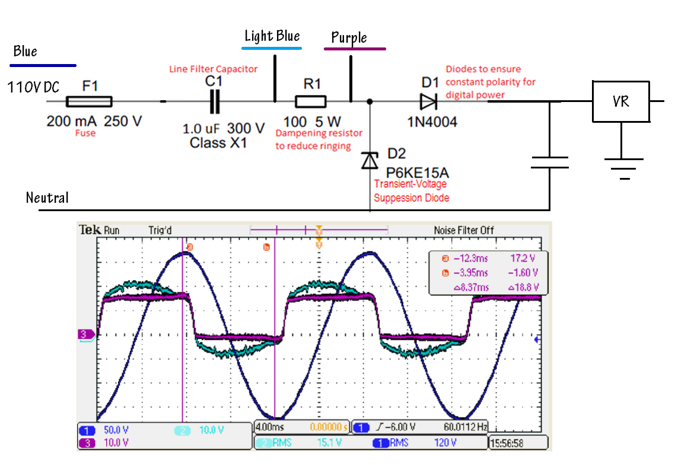
Voltage Regulator I

Slide 4
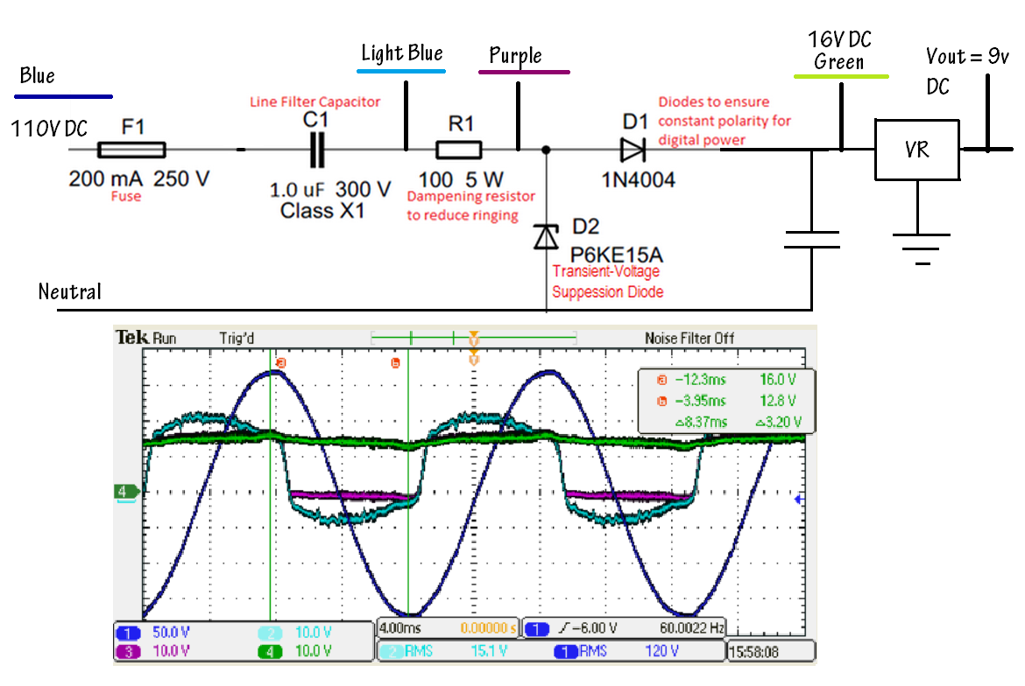
Voltage Regulator II

Slide 5
Voltage Regulator
Safety Testing (Connection with resistive load)
~20 hours total

Slide 6
Packing Update
Paul: No more packing box in the lab
Buy new packing box when new PCB design finished.
Plastic Vs. Metal

Slide 7
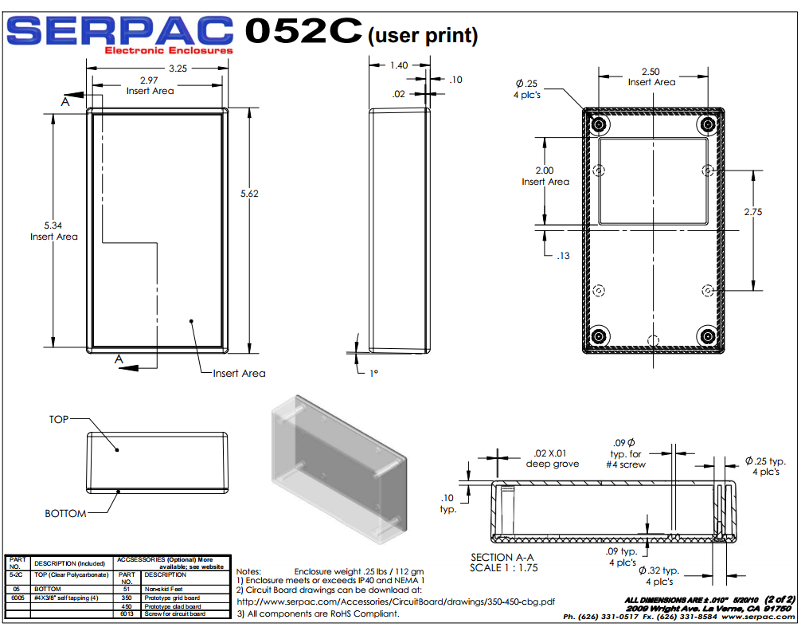
Sample

Slide 8
